Slide 1
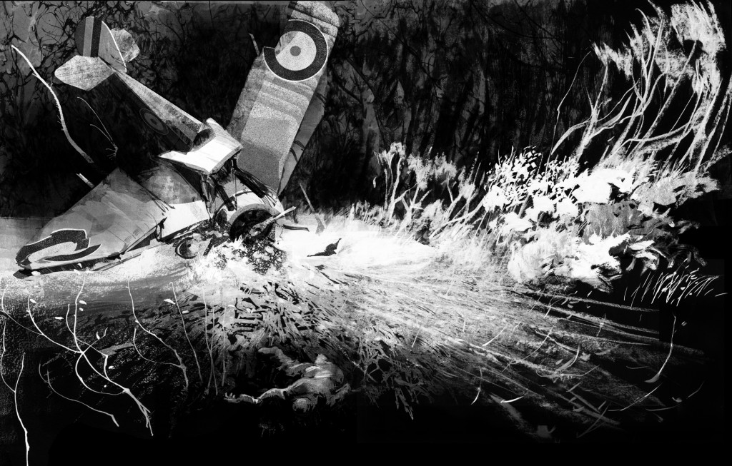

Slide 2
You manage to escape the wreckage. Your aircraft is destroyed so there is no hope of you returning to the skies. How are you going to get out of here?
You need to explore your surroundings and find shelter and food.
Go towards the beach. Go towards the jungle.

Slide 3
You make your way to the beach. There isn’t much here: some torn fishing nets on the shore, wood and plastic bottles washed up by the waves. There are a few tall palm trees with coconuts, and the sand is coarse and rocky.
Explore the beach further. Go towards the jungle.

Slide 4
There are lots of ferns where the sandy stretch meets the jungle. As you keep walking, you hear the sound of running water. A stream?
Explore the beach further.
Follow the sound of water.
Go towards the jungle.

Slide 5
The shore begins to curve out of sight. It looks like the rocks are getting bigger, the waves louder. What’s around the bend?
Go over the rocks.
Go back.

Slide 6
You climb over the rocks, taking care where to step. These rocks are jagged and wet.
You stumble, putting your hands out to stop the fall, and catch your palm on a rock. It’s quite a deep gash.
Wrap hand in shirt and keep going.
Go back.

Slide 7
There are lots of ferns where the sandy stretch meets the jungle. As you keep walking, you hear the sound of running water. A stream?
Make a shelter out of the wood and ferns.
Follow the sound of water.
Go towards the jungle.

Slide 8
The canopy is thick and the shade is welcome under the hot sun. You can hear birds and insects surrounding you. Life is everywhere. But is anyone else here?
You keep walking. It all looks very similar, until you come to a fork in the trail.
Go left. Go right.

Slide 9
You keep walking. You notice more flowers now – colour decorates the jungle. The sweet smell of nectar catches your attention. Could there be food here?
Keep walking.
Stop to look for food.

Slide 10
You catch a glimpse of a stream. It’s clean and shallow.
Stop for a drink.
Keep going.

Slide 11
THE END (FOR NOW)
Go back and choose another path.
Can you finish the story?
Perhaps you could write your own ‘choose your own adventure’ story.

